Slide 1
Cross-Tabulations and Significance Testing in XLDA and Snap
MKTG2341-09 PC Lab 10

Slide 2
Cross-Tabulations
MKTG2341-09 PC Lab 10

Slide 3
Cross-Tabulations
A relationship is a consistent and systematic linkage between variables.
Cross-tabulation analyses are used to examine relationships between two categorical variables.
Knowledge of relationships between variables is an important tool in analyzing segments.
MKTG2341-09 PC Lab 10

Slide 4
Cross-Tabulations
Examples:
Do men and women differ in their voting intentions?
Does the degree of satisfaction with customer service make any difference to likelihood of purchasing our products?
MKTG2341-09 PC Lab 10

Slide 5
Statistical Significance and
Cross-Tabulation Analysis
  Cross-tabulation analysis: assesses the statistical significance of categorical variable relationships.
  With cross-tabulation, the two variables are arranged in a row-and-column format.
  Cross-tabulation cell: is the intersection of a row and a column.
MKTG2341-09 PC Lab 10

Slide 6
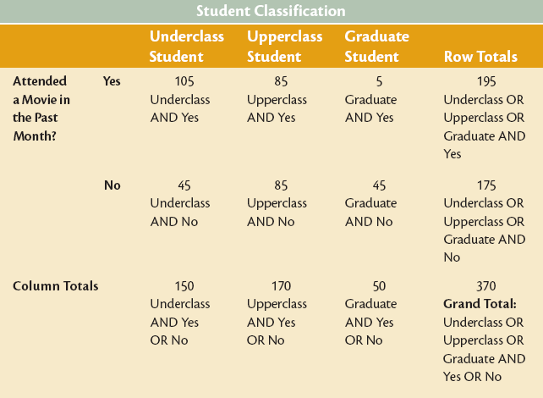
Components of the
Cross-Tabulation Table
MKTG2341-09 PC Lab 10

Slide 7
Cross-Tabulation Tables: Frequencies & Percentages
  The cross-tabulation table contains:
  Observed Frequency (raw counts).
  Percentages:
    Column percent
    Row percent
    Total percent
To simplify the data analysis, we will concentrate on analyzing the column percentages looking for trends across the rows.
MKTG2341-09 PC Lab 10

Slide 8
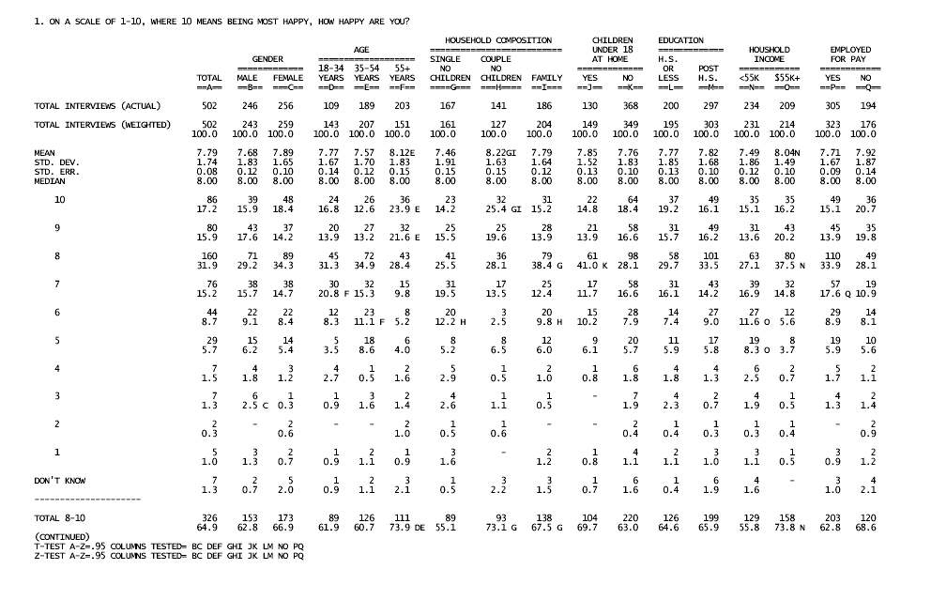
Cross-Tabulation Table Example
Cross-tabulation variable #1.
Cross-tabulation variable #2.
These are the frequencies.
These are the percentages.
MKTG2341-09 PC Lab 10

Slide 9
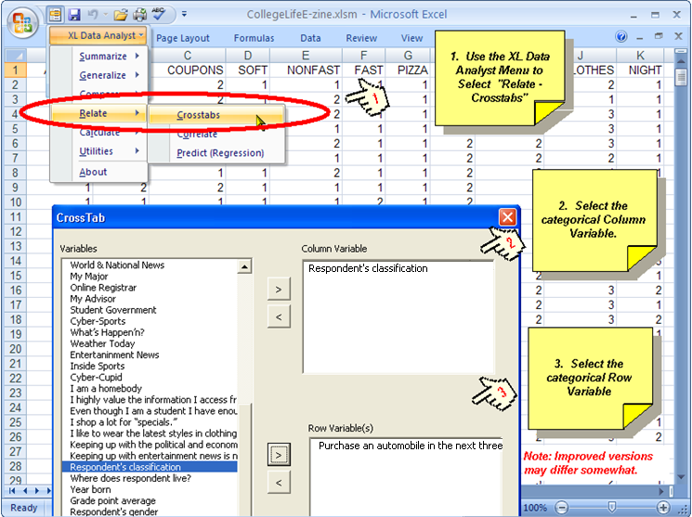
Cross-Tabulation Analysis
in XLDA
MKTG2341-09 PC Lab 10

Slide 10
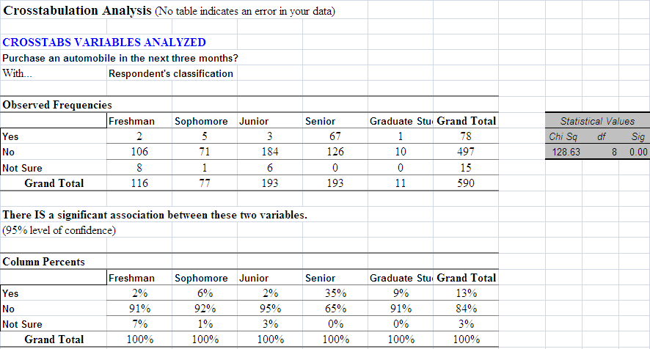
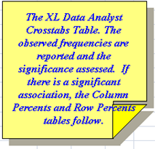
Cross-Tabulation Analysis
in XLDA
MKTG2341-09 PC Lab 10

Slide 11
Significance Testing
MKTG2341-09 PC Lab 10

Slide 12
Significance Testing
  Cross-tabulation tables can identify differences in the way specific groups respond to each question.
  We want to know if we can trust these differences – in other words, are the differences statistically significant.
  Statistically significant differences indicate true relationships between the variables.
MKTG2341-09 PC Lab 10

Slide 13
Significance Testing
  The main test we use to determine statistical significance between responses in a cross-tabulation table is the
  Chi-square Analysis
  If there is a significant difference, XLDA will automatically produce both column and row percentage tables for you.
MKTG2341-09 PC Lab 10

Slide 14
Significance test
in XLDA
MKTG2341-09 PC Lab 10

Slide 15
Interpret a Significant
Cross-Tabulation Finding
  If the chi-square analysis indicates that there is a significant relationship, we can move to the next stage.
  Determine the nature of the relationship by analyzing:
    the column percentages table, or
    the row percentages table
MKTG2341-09 PC Lab 10

Slide 16
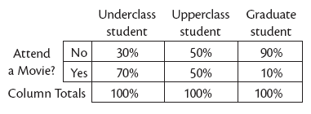
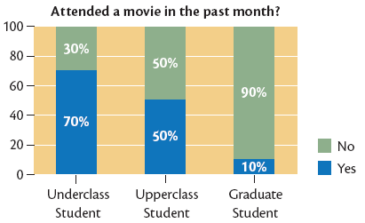
Column Percents in a
Cross-Tabulation Table
MKTG2341-09 PC Lab 10
Notes:
We will concentrate on column percentages

Slide 17
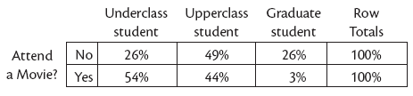
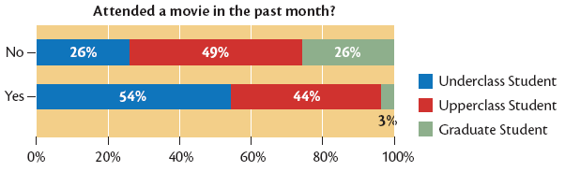
Row Percents in a
Cross-Tabulation Table
MKTG2341-09 PC Lab 10

Slide 18
Putting It All Together
MKTG2341-09 PC Lab 10

Slide 19
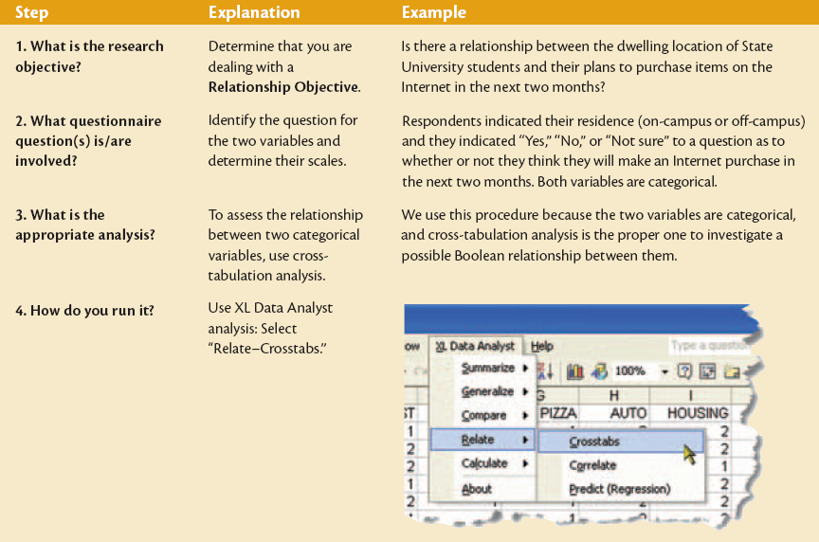
Six-Step Approach to
Analyzing Categorical Variables
With Cross-Tabulation
MKTG2341-09 PC Lab 10

Slide 20
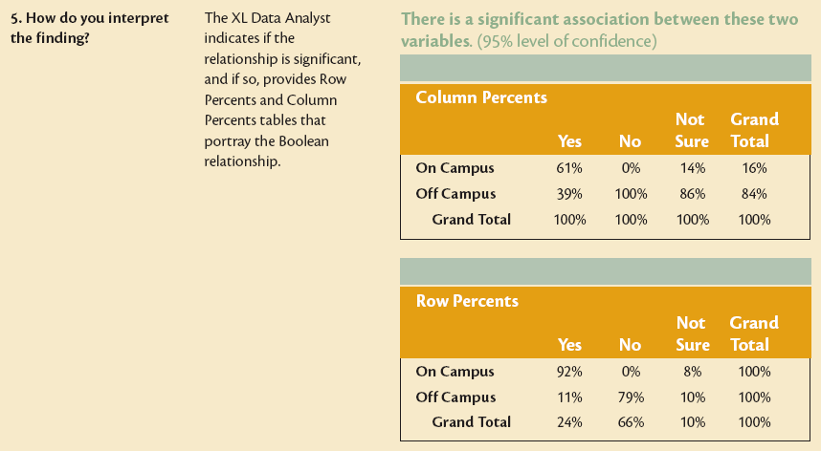
Six-Step Approach to
Analyzing Categorical Variables
With Cross-Tabulation
MKTG2341-09 PC Lab 10

Slide 21
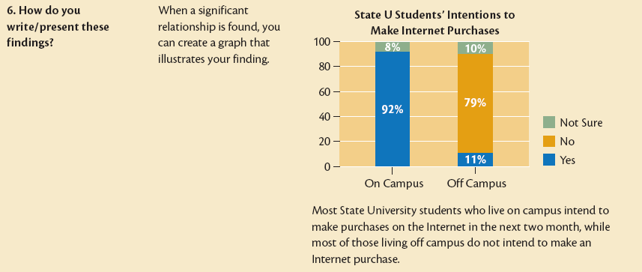
Six-Step Approach to
Analyzing Categorical Variables
with Cross-Tabulation
MKTG2341-09 PC Lab 10

Slide 22
Crosstabs in Snap
MKTG2341-09 PC Lab 10

Slide 23
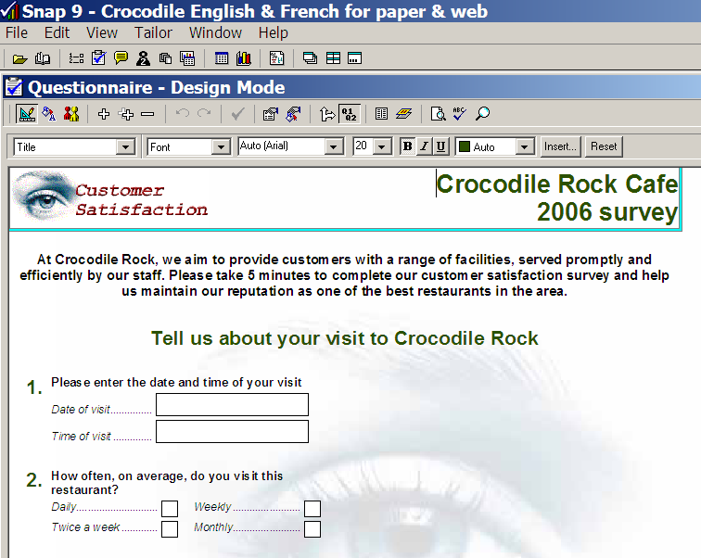
STEP 2:
Choose ‘Results Table’
STEP 1:
Choose ‘Variables’
MKTG2341-09 PC Lab 10

Slide 24
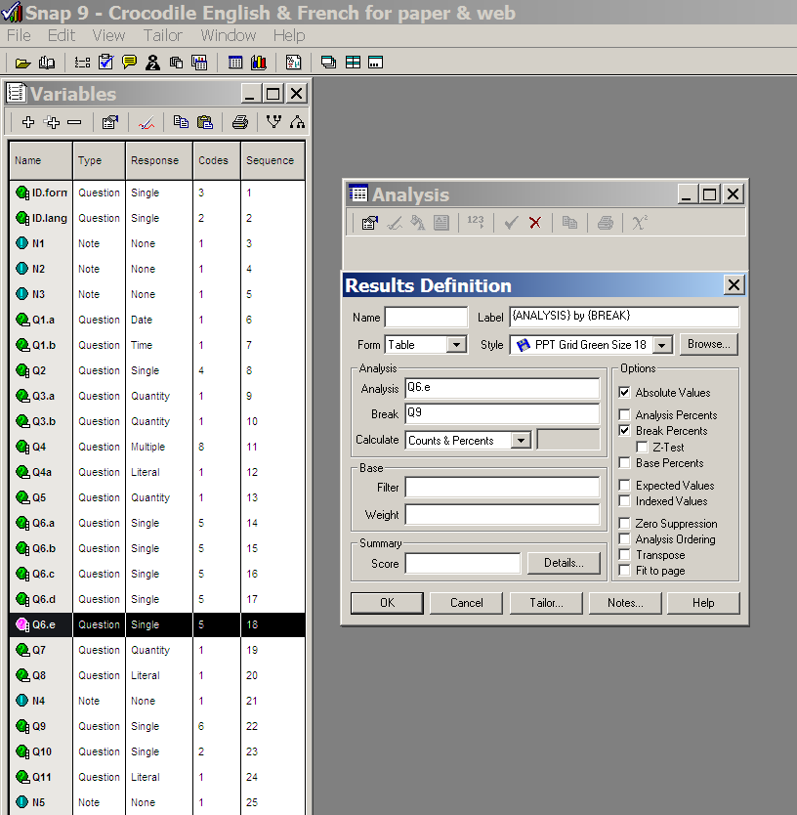
Dependent Variable = Analysis Variable (in columns).
Independent Variable = Break Variable (in rows).
MKTG2341-09 PC Lab 10

Slide 25
STEP 4: Choose ‘Absolute Values’ & ‘Break Percents’
STEP 3: From the ‘Variables’ menu, drag and drop the questions that you want to cross-tabulate into the ‘Analysis’ and ‘Break’ boxes in the ‘Results Definition screen
Column % = Break %
MKTG2341-09 PC Lab 10

Slide 26
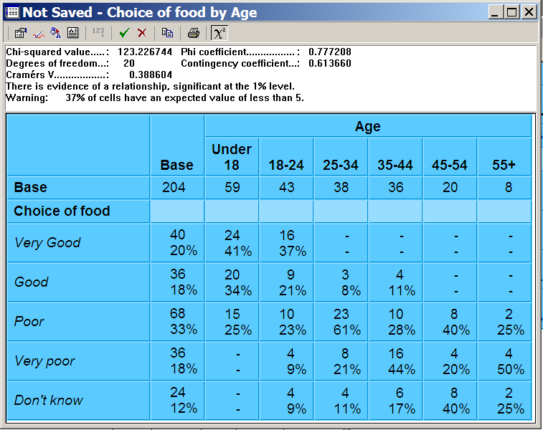
Crosstab Table in Snap
Hitting the χ² button…
…will produce significance statistics.
MKTG2341-09 PC Lab 10

Slide 27
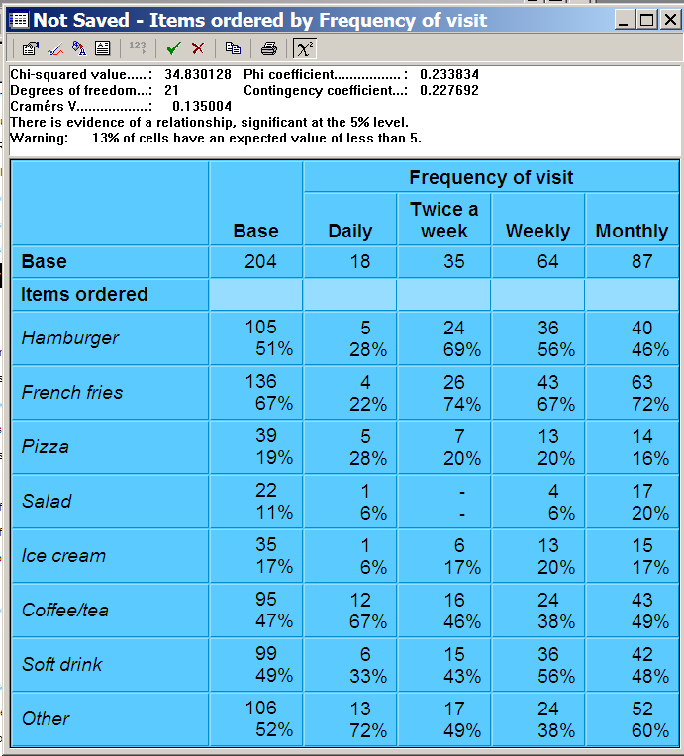
Crosstab with
Multiple Response
Base:
Number of Customers
Percent:
Break % (= Col %)
MKTG2341-09 PC Lab 10

Slide 28
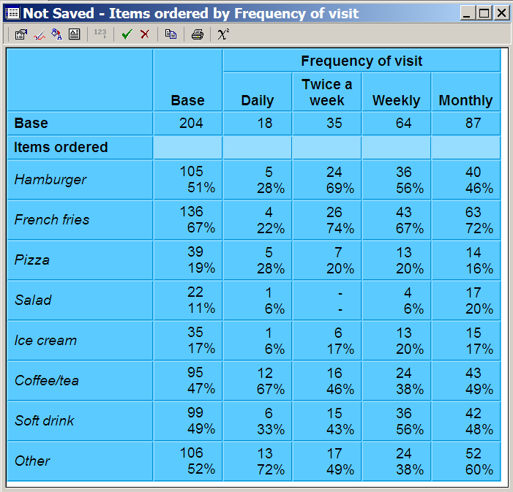
Multiple Response:
Customers, Break %
Because the dependent variable is Multiple Response, the column percents don’t add up to 100%.
Analysis:
Base: # of Customers
Pct: Break % (= Col %)
Calculation:
12/18=67%
Interpretation:
Daily customers are much more likely to order coffee/tea than any other customer groups.
MKTG2341-09 PC Lab 10

Slide 29
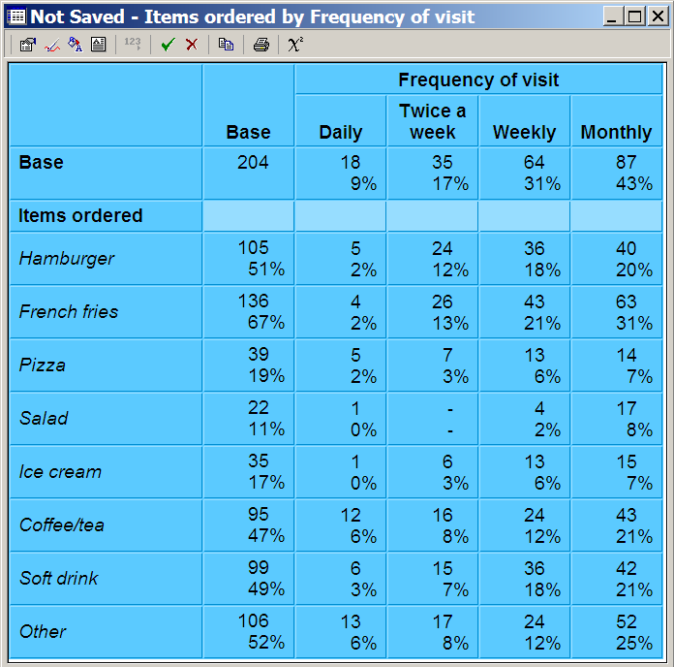
Multiple Response:
Customers, Base %
Analysis:
Base: # of Customers
Pct: Base % (=Total %)
Calculation:
12/204=6%
Interpretation:
Daily Customers account for one-tenth of all customers.
Approximately one-half of all customers ordered coffee/tea.
While Daily customers are more likely to order coffee/tea than soft drinks, their coffee/tea orders still account for only 6% of all food orders.
MKTG2341-09 PC Lab 10

Slide 30
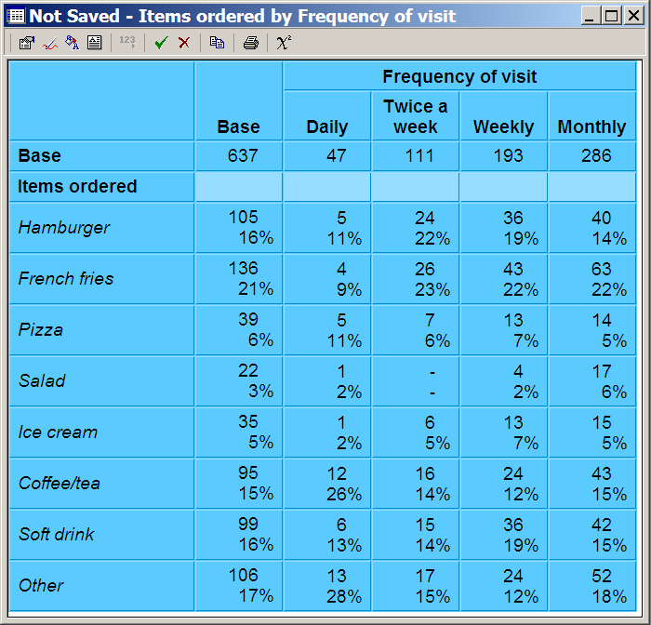
Multiple Response:
Food Orders, Break %
Analysis:
Base: # of food orders.
Pct: Break % (= Col %).
Calculation:
12/47=26%
Interpretation:
One quarter of all food orders placed by Daily customers were for coffee/tea.
MKTG2341-09 PC Lab 10

Slide 31
Interpretation of Crosstab with Multiple Response
When analyzing cross-tabulation data:
Look for differences between percentages reported in different columns. For example, menu items ordered by women versus men.
Look for trends across individual rows. For example, does propensity to order coffee/tea differ by frequency of visit to the café. (It does, from 6% among Daily visitors to 21% of Monthly visitors.)
MKTG2341-09 PC Lab 10

Slide 32
Over to you…
Crosstabs in XLDA:
Using the College Life E-Zine database, produce one cross-tabulation table.
In choosing your variables, think about results that could be used for marketing purposes!
Note whether or not differences between percentages are statistically significant.
Crosstabs in Snap:
Using the Crocodile database, produce a cross-tabulation table with the Multiple Response variable (Q4) as the dependent variable and a variable other than Q2 as the independent variable.
Note whether or not differences between percentages are statistically significant.
MKTG2341-09 PC Lab 10

